Slide 1
Porter’s Five Forces Model
It is a framework for analyzing an industry's competitive environment by assessing five key forces that determine its attractiveness and profitability.

Slide 2
These five forces were developed by Harvard business professor Michael Porter who wrote about the strategic analysis model in the Harvard Business Review in 1979.1 Harvard Business Review: "How Competitive Forces Shape Strategy." Pages 137-145

Slide 3
DEFINITION
Porter’s Five Forces are used to identify and analyze the forces that shape the competitive nature and intensity of a market or industry.

Slide 4
Five Forces
Rivalry among existing competitors
Threat of new entrants
Bargaining power of suppliers
Bargaining power of buyers
Threat of substitute products or services

Slide 5
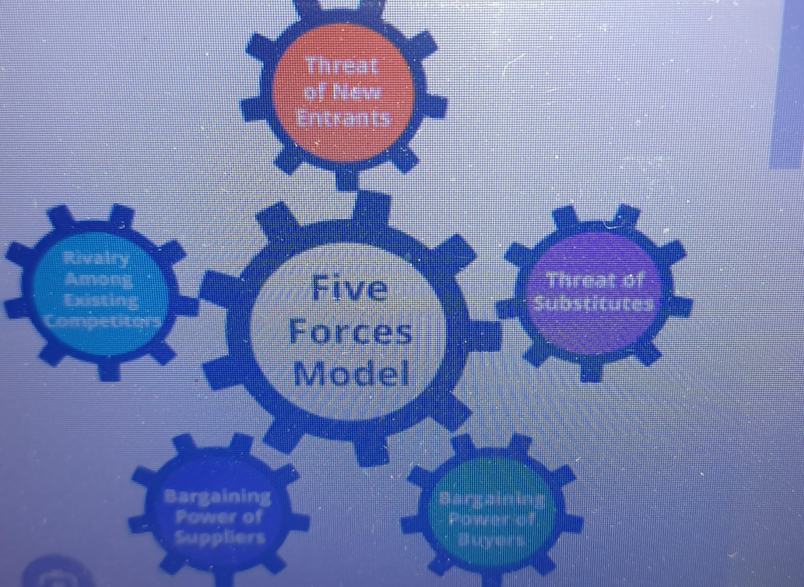

Slide 6
Competitive Rivals:
This force examines the intensity of competition within the industry, considering factors like the number of competitors, their size and market share, product differentiation, and switching costs.

Slide 7
Competitive Rivals: business competition
Rivals like Pepsi and Coke for soft drinks Apple and Samsung for Smart phones, Nike and Adidas for sneakers,
Ford and GM for autos
The rivalries are so influential that consumers split culturally among those who have an i-Phone or prefer Nike shoes. Thus, it's no accident that we also consider business competition a war among rivals.

Slide 8
Rivalries can lead to price wars, high-priced marketing battles, and races for slight advances that could mean a competitive advantage. These tactics can stimulate companies to make even better products but also erode profits and market stability.

Slide 9
The number of competitors: More competitors means a fierce rivalry where each fights for scraps of market share.
Industry growth: Competition is usually less dramatic because the market grows so fast that competitors have little need to fight for customers—think of the automobile, electronic goods industry of the early 20th century. Competition can be ferocious in a declining industry as firms fight for a larger piece of a shrinking pie, such as in the ‘media industry’ of today

Slide 10
Similarities in what's offered: Competition tends to be intense because customers can easily switch when goods and services are very similar. However, a unique offering or brand loyalty can reduce competitive rivalry. Apple comes to mind in tech goods, just as Rao's Italian sauces or Amul Butter do in your supermarket aisles, each charging a higher price given whatever makes it unique.

Slide 11
Exit barriers: When it's difficult or costly for companies to leave the industry due to specialized assets, contractual obligations, or emotional attachment, they may choose to stay and compete, even if the market's prospects grow dimmer. For instance, airlines have high costs which means that when airlines face a shrinking market—or even an unprofitable route—they can't retreat from the market quickly.

Slide 12
Fixed costs: Porter notes that if an industry has high fixed costs, companies have a "strong temptation" to cut prices rather than slow production when demand slackens. Paper and aluminum manufacturing are two good examples that Porter mentions.

Slide 13
Threat of New Entrants:
This force assesses the ease with which new companies can enter the market and compete, considering barriers to entry like high capital requirements, regulatory hurdles, and established brand recognition.

Slide 14
Industries where new firms can enter more easily almost always have lower profit margins, and the firms involved each have less market share
The sector for local restaurants has relatively low entry requirements: there aren't significant investments or regulatory hurdles before opening to the public. Thus, it's also the case that your favorite restaurant may not stay open for long, given the hypercompetitive environment and constant openings of new restaurants.

Slide 15
Here are factors in measuring how much new entrants threaten an industry:
Economies of scale: Industries where large-scale production leads to lower costs face less of a threat from new entrants. New firms would need to achieve a similar size to compete on price, which might be difficult or costly.
, the threat of entry is lower

Slide 16
Product differentiation: When existing firms have strong brand identities or customer loyalty, it's harder for new entrants to gain market share, reducing the threat of entry.
Capital requirements: High startup costs for equipment, facilities, etc., can deter new entrants. For example, starting a car manufacturing business requires significant investment

Slide 17
Access to distribution channels: If existing firms control the distribution channels—retail stores, online platforms, cable infrastructure, etc.—then new entrants would need to find a way to replicate that structure while competing with the established firms on price, a tricky proposition.

Slide 18
Regulations: Licenses, safety standards, and other regulatory standards can create barriers, making it too ungainly or costly for new firms to enter the market. Examples include those looking to build new hotels in downtown areas or supply power to a region.
Switching costs: If it's costly or difficult for customers to switch from existing firms to new entrants

Slide 19
Bargaining Power of Suppliers:
This force evaluates the influence suppliers have over the industry, considering factors like the concentration of suppliers, the importance of their inputs, and the availability of substitutes.

Slide 20
Suppliers are powerful when they are the only source of something important that a firm needs, can differentiate their product, or have strong brands. Higher supplier power in an industry raises costs or otherwise limits the resources a firm needs. Here are some factors used to measure the supplier power of an industry:

Slide 21
Number of suppliers: When few firms can give a company something it needs to stay in business, each has greater negotiating power. They can raise prices or reduce quality without fear of losing business.
Uniqueness: If a supplier provides a unique product or it's not easy to find a substitute, it is more dominant. Businesses can't easily switch to another supplier.

Slide 22
Switching costs: If it's costly or time-consuming to switch suppliers, then they have more power. Businesses are less likely to switch, even if prices increase.
Forward integration: If suppliers can move into the buyer's industry, they have more power. They already have access to the necessary supplies, making it difficult for their former buyers to compete once they decide to enter the market themselves.

Slide 23
Industry importance: Some sectors are tightly intertwined, such as automotive suppliers and the major auto companies or the semiconductor and tech industries, which can balance the power between the suppliers and those in the sector. This is because the supplier needs these buyers to do well so that it can, too. When a supplier can just as easily sell its products elsewhere, that gives it a great deal more power.

Slide 24
Bargaining Power of Buyers: OR Customer Power
This force assesses the influence customers have over the industry, considering factors like their concentration, their sensitivity to price changes, and the availability of substitutes.

Slide 25
The number of buyers: Fewer buyers mean more power. In sectors like aerospace manufacturing, each major airline (the industry's customers) has significant leverage in negotiations and can demand favorable terms because the sellers depend on their business.
Purchase size: Just like you head off to the big box stores to buy in bulk for a cheaper per-unit cost on whatever now fills up your garage, major retail chains like Walmart (WMT) buy in large volumes and can negotiate better terms and discounts.

Slide 26
Switching costs: In industries like telecommunications, where it's easy for consumers to switch providers, companies such as Verizon (VZ) and AT&T (T) have to offer competitive terms.
Price sensitivity: In the fast-fashion industry, where customers are highly price-sensitive, brands must keep their prices low to attract cost-conscious consumers.
Informed buyers: In many sectors, the customers are savvy, know the competitive terrain well, and thus can negotiate better prices.

Slide 27
Threat of Substitute Products or Services:
This force examines the likelihood of alternative products or services being used to fulfill the same needs as the industry's offerings, considering factors like the availability and price of substitutes.

Slide 28
Relative price performance: If a substitute's cost is lower and its performance is comparable or better, customers are likely to switch to the substitute. For instance, streaming services like Netflix (NFLX) became a substitute for traditional cable TV, providing a lower price that threatened the cable industry.
Customer willingness to go elsewhere: The threat is high if buyers find it easy to switch to a substitute. For example, customers found switching from taxis to ride-sharing apps like Uber or Lyft cheaper and easier.

Slide 29
The sense that products are similar: If buyers perceive that there are few differences between your product and a substitute, they are more likely to switch. There are times when potential substitutes are very different from a company's products but consumers still treat them as the same
Availability of close substitutes In other cases, there are genuinely similar products in the market and the threat of substitutes is high, such as between brand-name and generic medications.

Slide 30
In essence, Porter's Five Forces framework provides a structured way to analyze the competitive landscape of an industry, helping businesses understand the forces that drive profitability and make informed strategic decisions..

Slide 31
Purpose of the Framework:
Porter's Five Forces helps businesses understand the dynamics of their industry, identify potential opportunities and threats, and develop strategies to improve their competitive position. By analyzing these five forces, companies can assess the overall attractiveness of an industry and determine whether it is likely to be profitable

Slide 32
FAST FOOD V/S FAST CASUAL :
Fast-casual restaurant chains offer higher-quality food in an informal setting.
The leaders in this sector are outpacing more traditional fast-food outlets in growth.
The fast-food industry is responding with a wider variety of menu options.
Fast-Casual
Fast-casual restaurants offer consumers freshly-prepared, higher-quality food in an informal setting, with counter service to keep things speedy

Slide 33
Combining the ambiance and meal quality comparable to casual dining with the convenience of a quick-service chain, the fast-casual industry has been a model for current and future success. A number of factors, including affordability in conjunction with quality, taste, convenience, and customer service, form the basis of the business model for fast-casual outlets.

Slide 34
Fast-food chains earned much of their success by offering quick, inexpensive meals that are always made exactly the same way. However, over the last few years, fast-casual restaurants have continued to eat into the market share of leading quick-service chains.

Slide 35
Consumption trends toward organic choices, fast-food chains could see some of their market share eaten into as time goes on. Traditionally, fast food chains gained market share by offering simpler and cheaper alternatives. Fast-casual chains stepped in to provide consumers with wholesome, albeit pricier, selections.
options.

Slide 36
The fast-food industry is not ignoring the trend. In late 2018, McDonald's announced that it was removing all preservatives, fake colors, and other artificial ingredients from seven of its burger selections. Its menu now features a Grilled Chicken Salad, and you can get apple slices with a kid's Happy Meal.
McDonald's. "Wraps & Salads."
Customers at Taco Bell can also choose healthier vegetarian options

